Slide 1

Smartz Graphics - Final Deliverable
3/14/2017
Consult Your Community - UC Davis
Notes:
How did the business taxes go?
Where do you see your business in 6-12 months? Full time/part time goals?
Have there been any changes or updates?

Slide 3
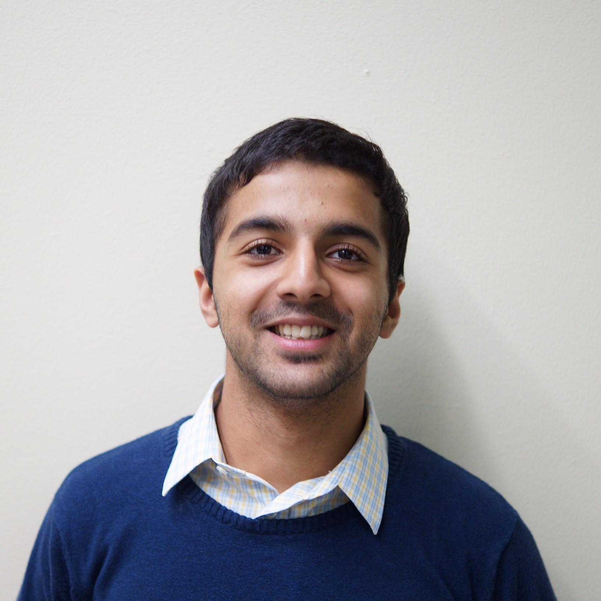
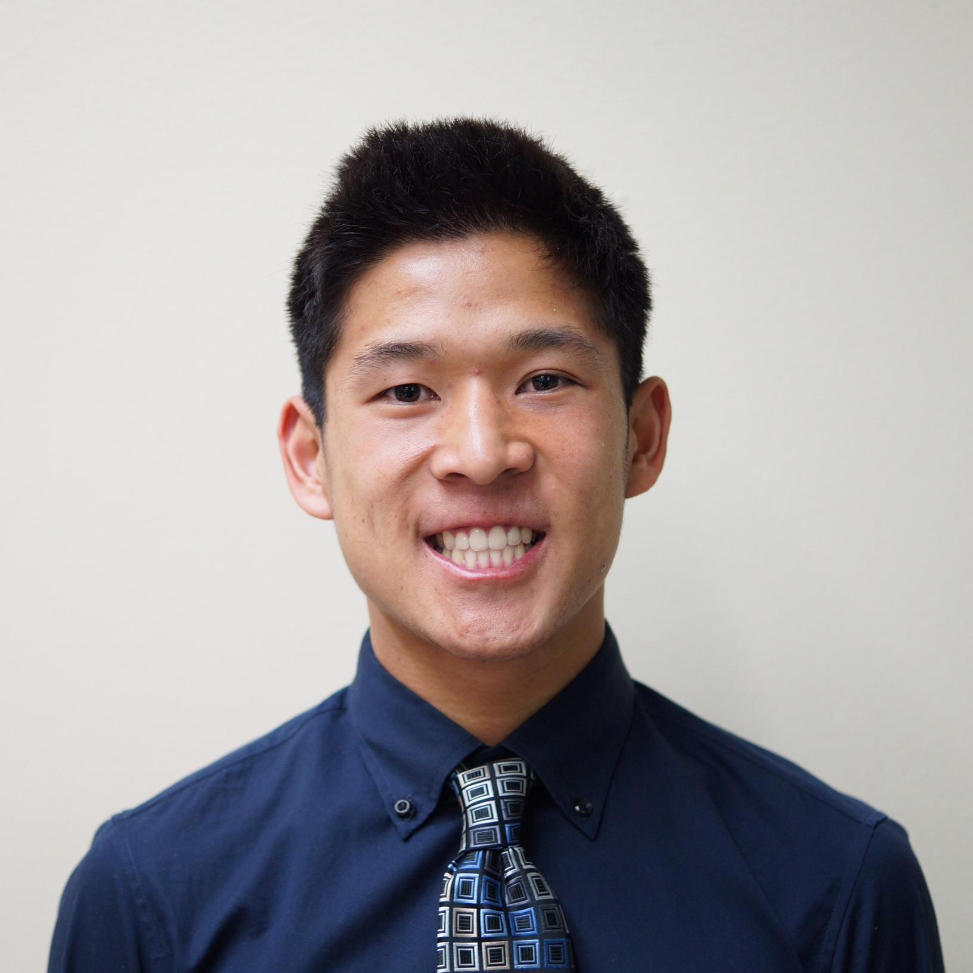
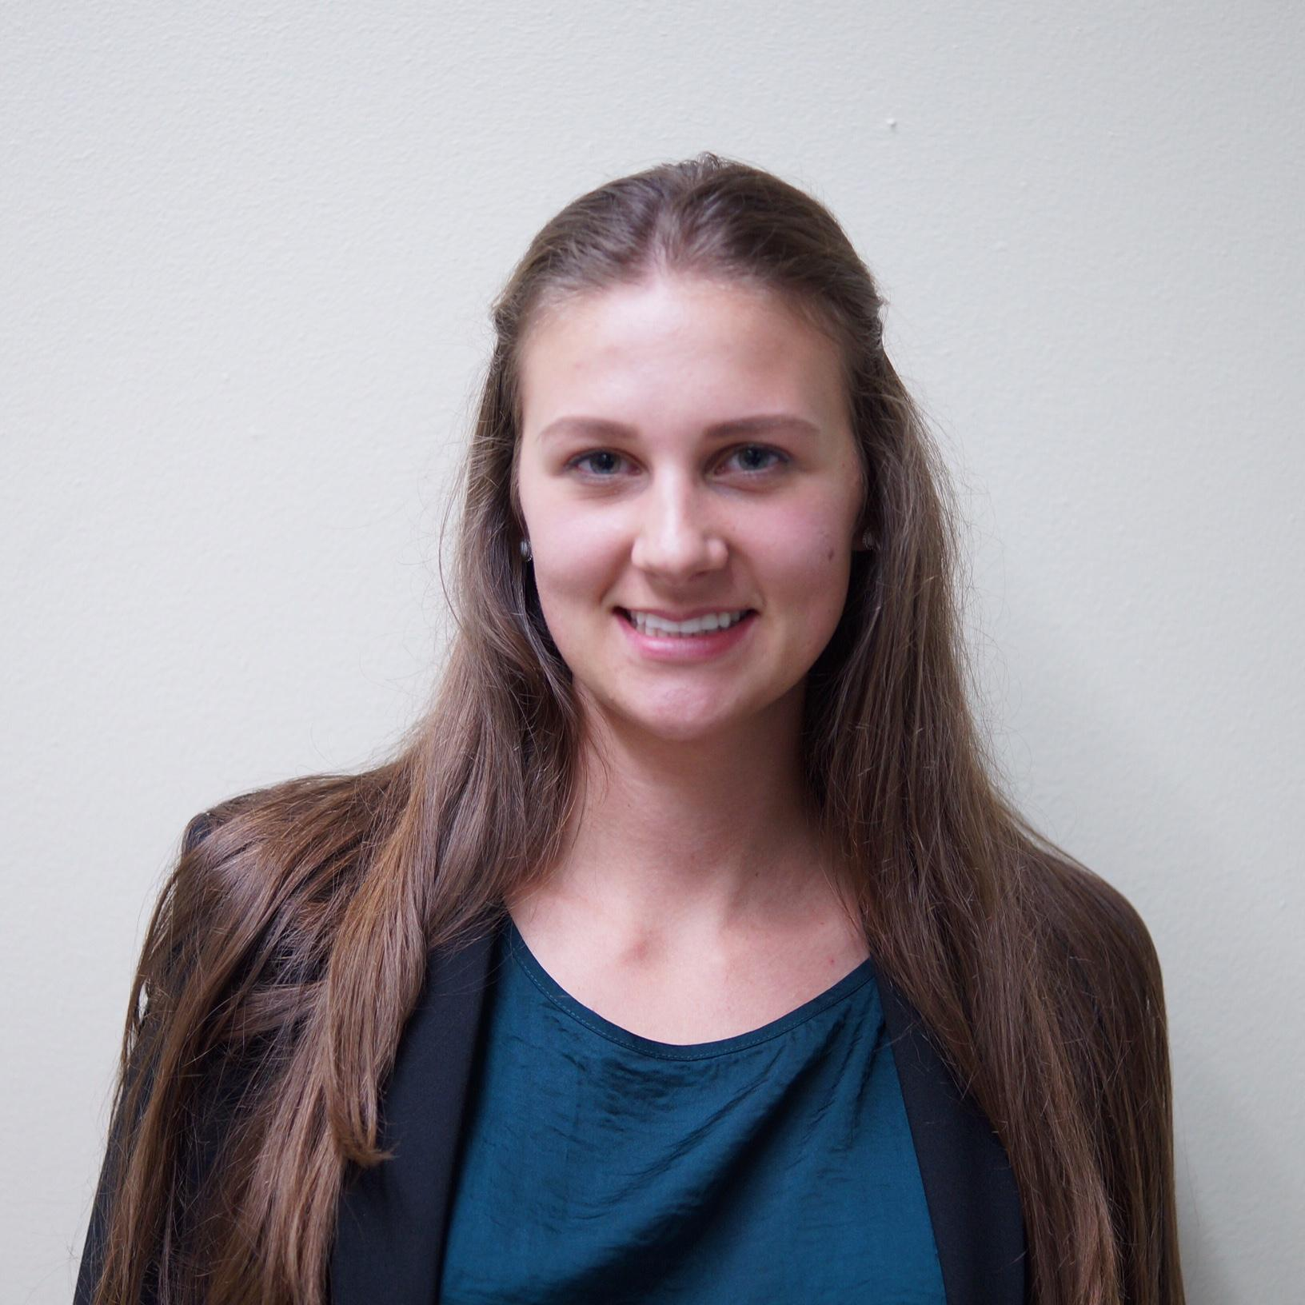
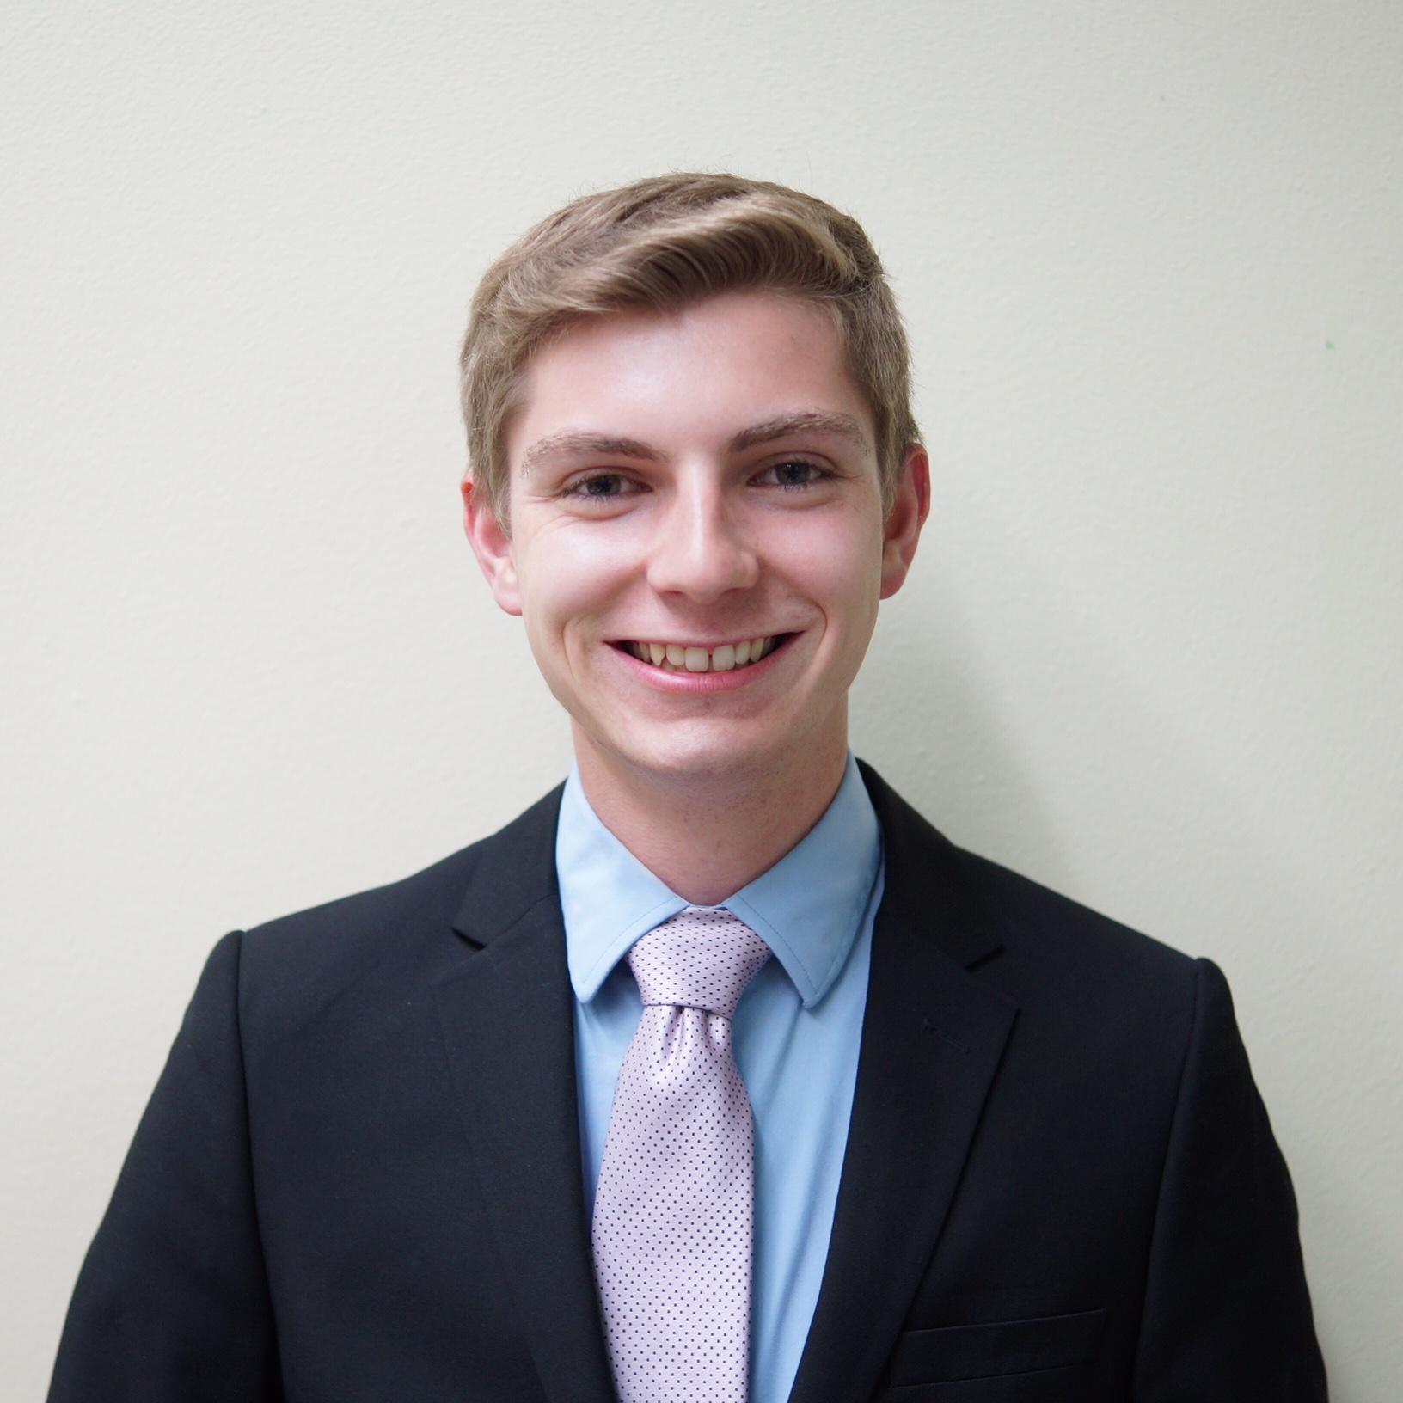
Meet the Team
Taymour Siddiqui Jordan Lim Emanuella Mikityuk Zac Bouchard Matthew Lee

Slide 4
Overview
Midpoint Review | 5
Website Feedback | 6-12
Building an Online Presence | 13-17
Finding a Mentor | 18-21
Community Involvement | 22-23
Adobe Certification | 24-26
Recommendation | 27-28
Conclusion | 29

Slide 5
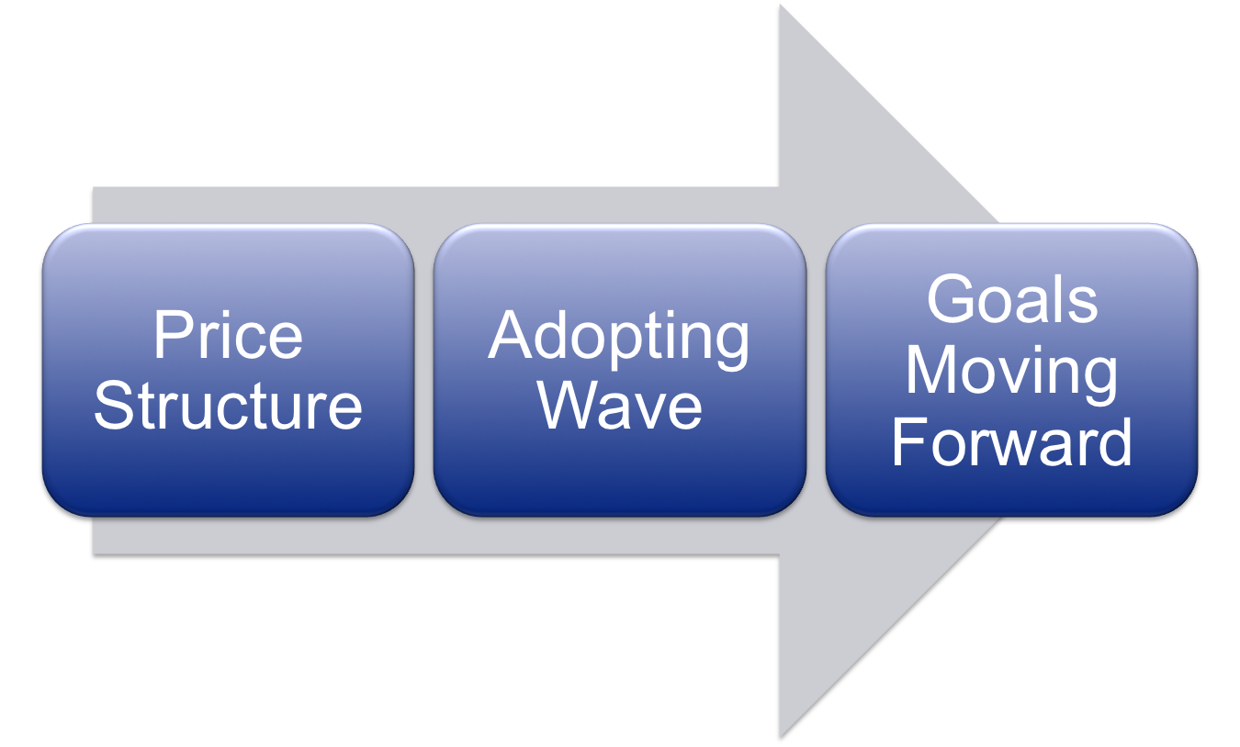
Midpoint Review

Slide 6
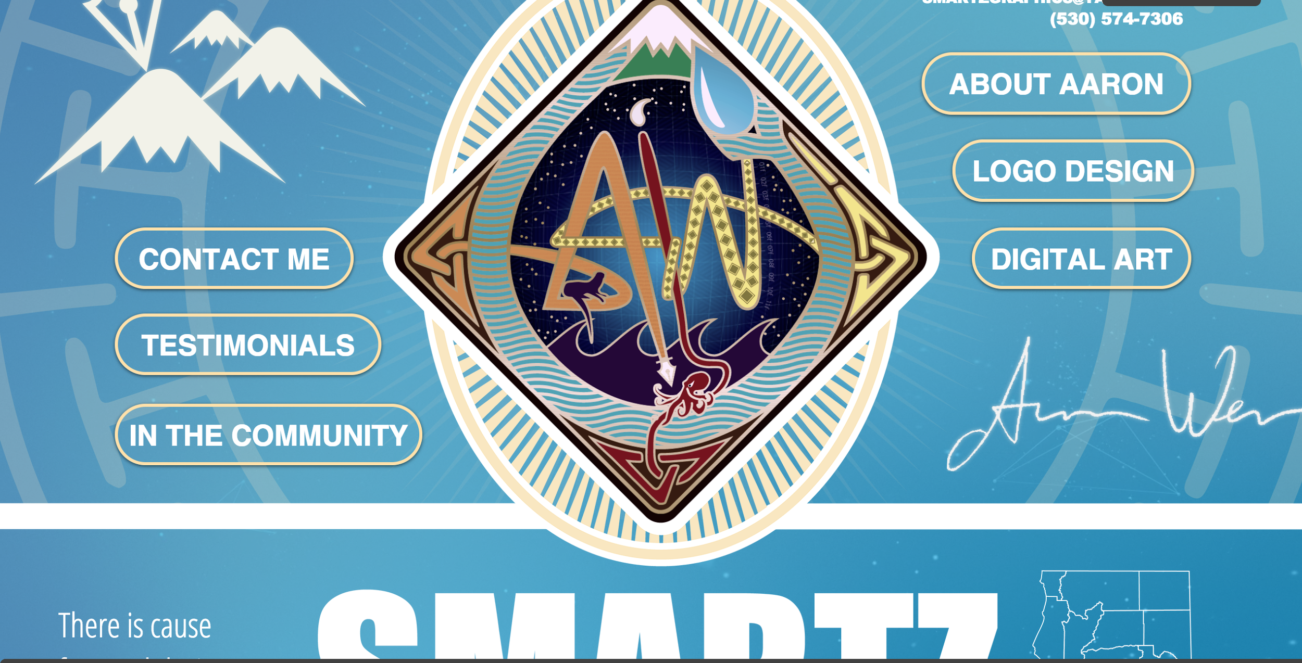
Home Page
Great Qualities
Ideas & Suggestions
Concise Navigation Buttons
Blue Background
Like the floating background graphics
Cannot easily see the name of the business
Everything is too big (gives ability to scroll to the sides and to the bottom)
Change order of the buttons to have about me on the left (read left to right)
the logo is too big
everything is too large
Notes:
Emanuella
why do you have two home pages? please fix this

Slide 7
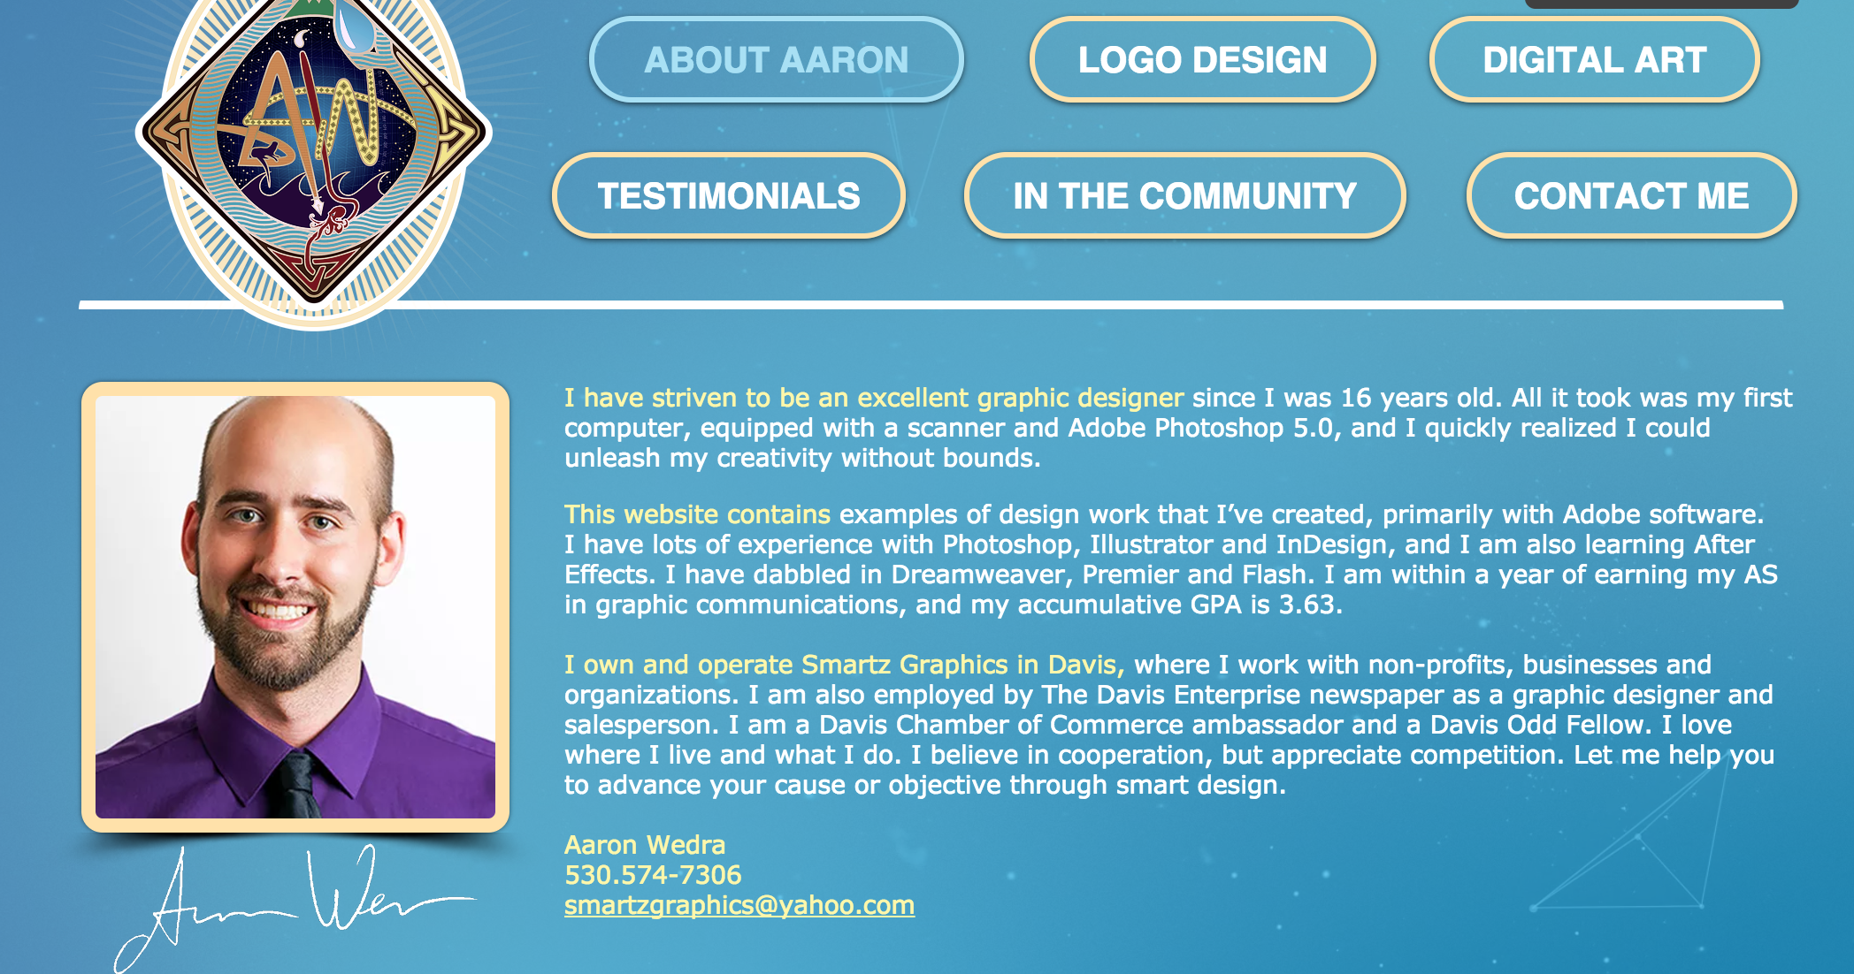
About Aaron
Great Qualities
Ideas & Suggestions
Great format for the buttons and the logo
Signature is a great touch
Phone Number Edit (530).574-7306
“Accumulative GPA” = Cumulative (Not sure on the relevance)
Capitalize your major
Notes:
Jordan
stick to one color font

Slide 8
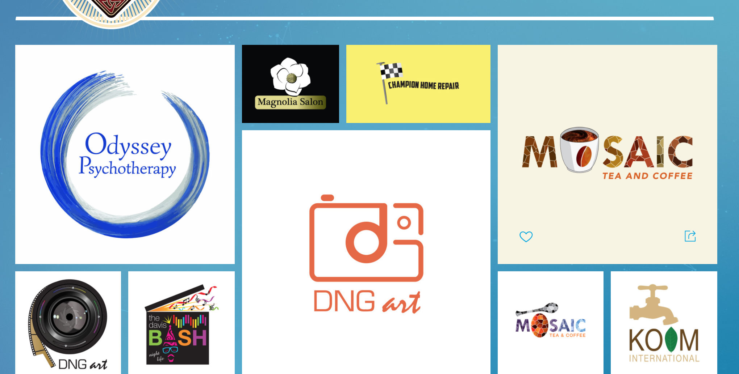
Logo Design
Great Qualities
Ideas & Suggestions
Nice Variety of logos used
Great way of grouping the photos together
Some of the logos like DNG are too big
Too much wave at the bottom of the screen (for all pages)
Notes:
Jordan

Slide 9
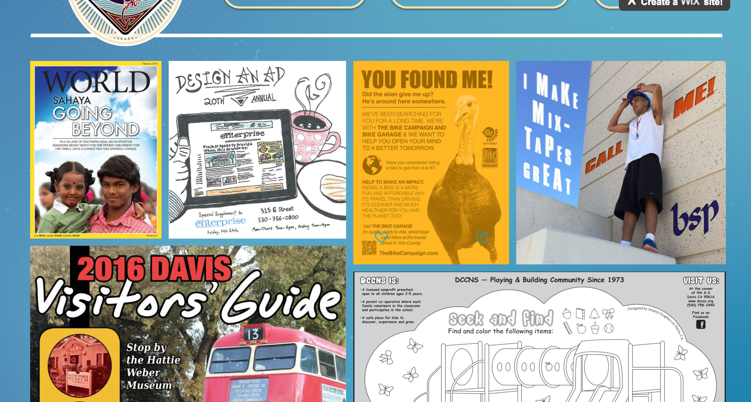
Digital Art
Great Qualities
Ideas & Suggestions
Great presentation of variety of media
Good use of large and small graphics
Nick Graham Photography is a logo and should not be in this section
White line half-way down? Categorize
Use 3 images per row to make it less busy (larger use of breaks between images)
Notes:
Taymour

Slide 10
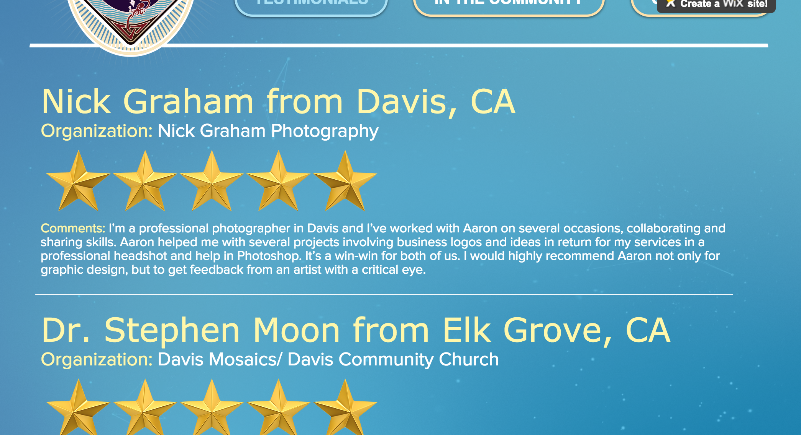
Testimonials
Great Qualities
Ideas & Suggestions
Awesome idea
Lots of great feedback given
Do not like the stars (Yelpish feel)
Make actual review larger (emphasis on the text with quotation marks)
Minimize the name and organization, have them after the review
Notes:
Taymour

Slide 11
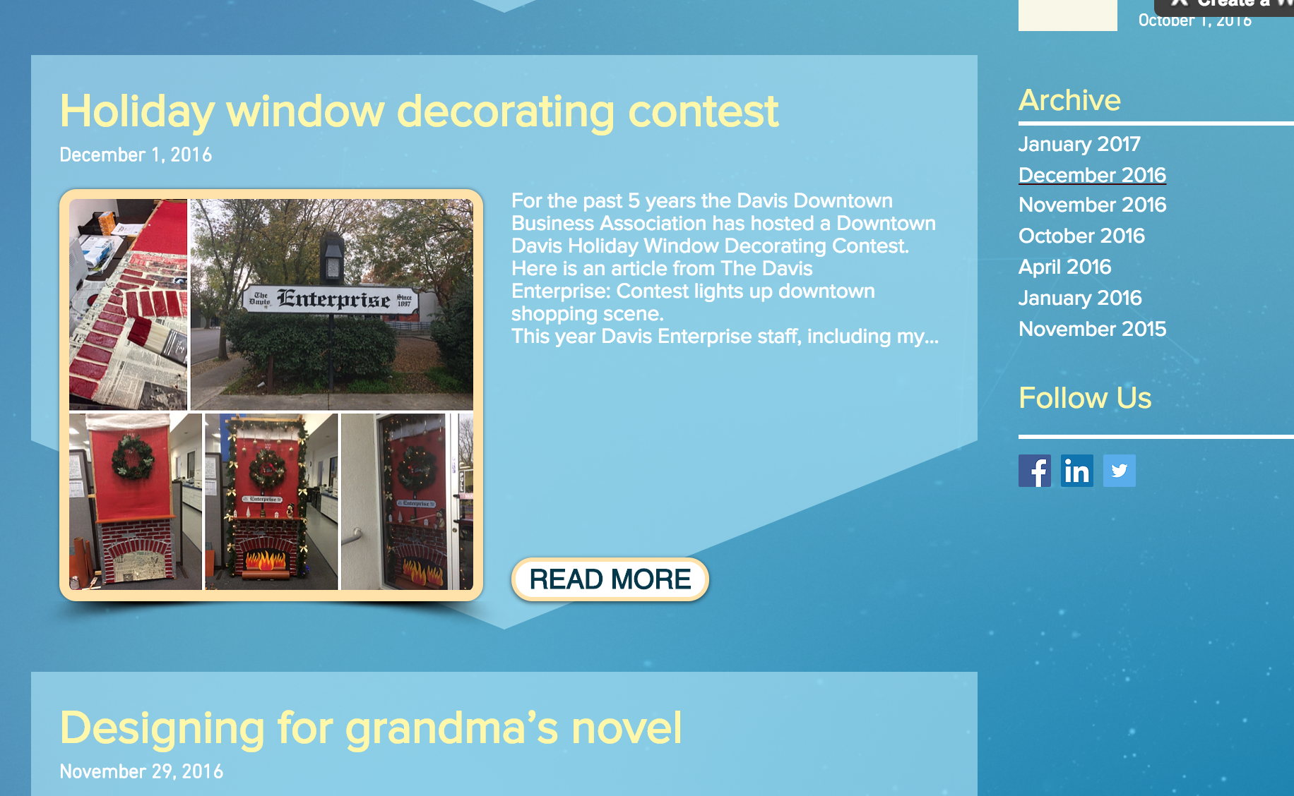
In the Community
Great Qualities
Ideas & Suggestions
Love the layout of the page
Love the archive section
Hyperlinks need to go somewhere if you are going to have them
Notes:
Zac

Slide 12
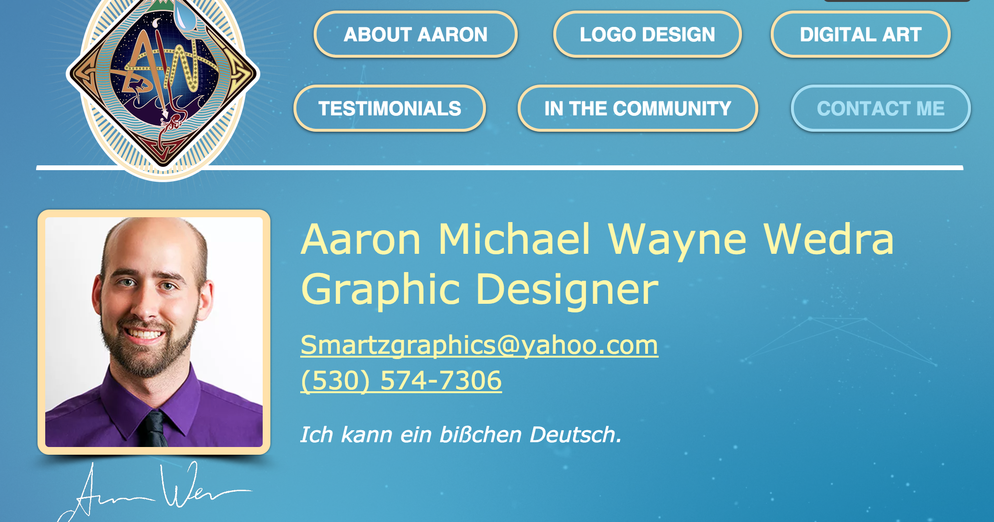
Contact Me
Great Qualities
Ideas & Suggestions
Great use of the signature
Nice touch with the German phrase
Full name should be in “About Me”
What is the difference between this page and the “About Me” section?
Great place to put in a questionnaire/form
Graphic Designer title is too big
Notes:
Zac

Slide 13
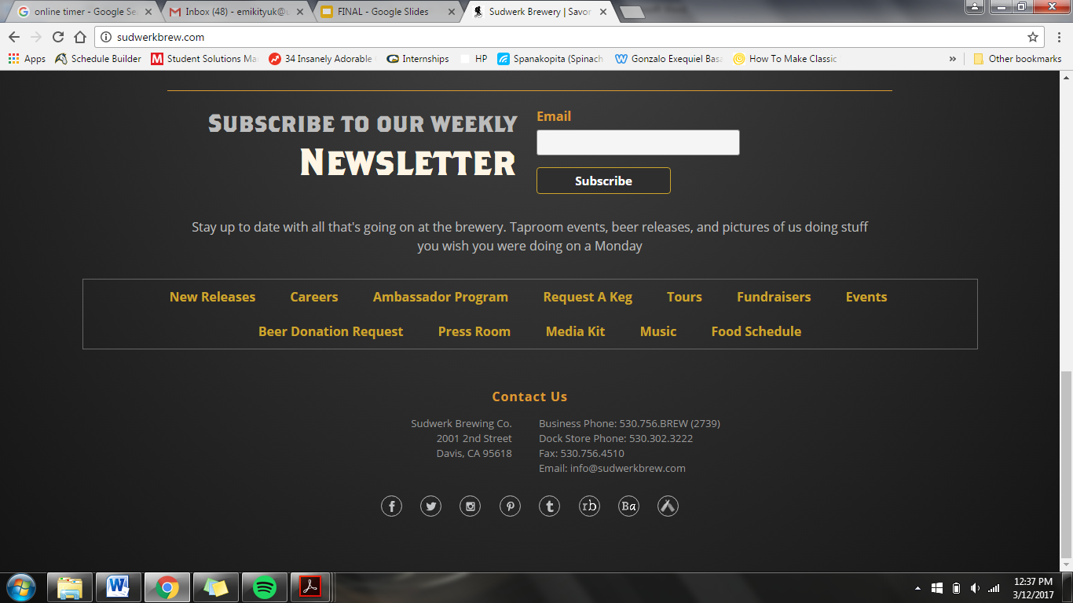
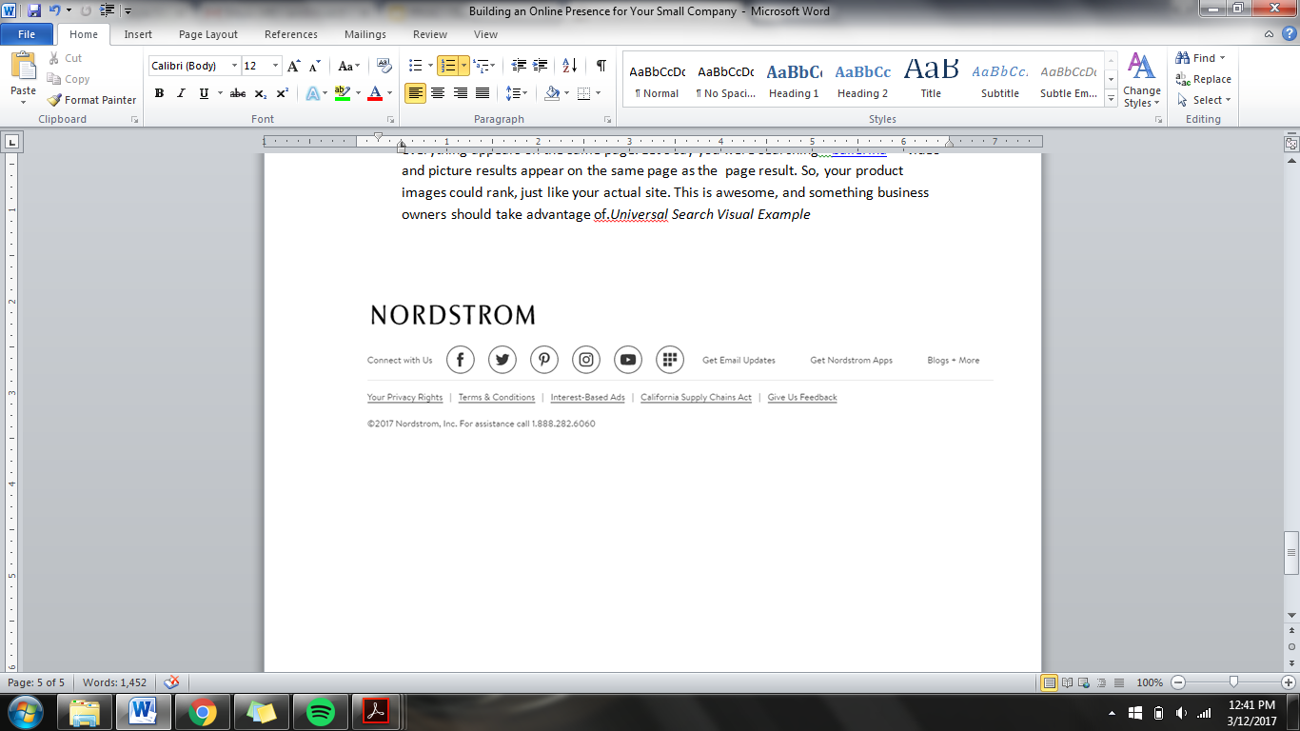
Building an Online Presence
“Ninety-seven percent of consumers go online prior to making a purchase to research products and services locally.”
WHY?
Credibility
Transparency with customers
Social Networking - Branding
Notes:
BIA/Kelsey = a marketing first that does R&D in online marketing
Create a strong social media in the next month.
Branding over Social Media: people will be able to identify you with your work

Slide 14
Building an Online Presence
How? Systematically
Create a company website ✔
Create a social media account (or two)
Facebook
Link website to social media
Goal: TRAFFIC!
Notes:
Your site really needs to compatible with mobile.

Slide 15
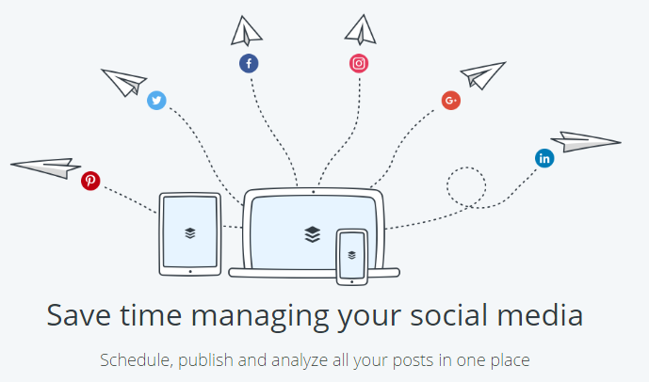
Building an Online Presence
Short and Sweet and with Pictures
How to post on Social Media: it’s cheaper than traditional marketing!
Create Targeted Content
write for your audience, not yourself
Ignore “sales pitches”, help and educate
Helpful Content gets Shared
Use visuals!
53% more likes, 104% more comments
And you get to share your content!
Post regularly!*****
once a week, twice a week, etc
use creative hashtags like #WisdomWednesdays
Forbes: Posting 1-5 times a month will double your clicks.
Buffer
free online platform to schedule social media
posts in advance
Notes:
We would love to see your “Community Page” online because it is exactly what a social media account should look like.
You want to use these ties to bring traffic onto your site.

Slide 16
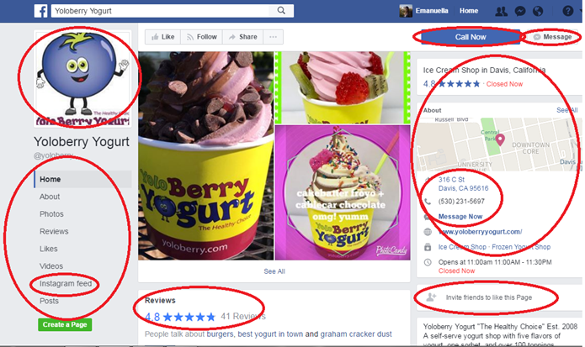
Building an Online Presence

Slide 17
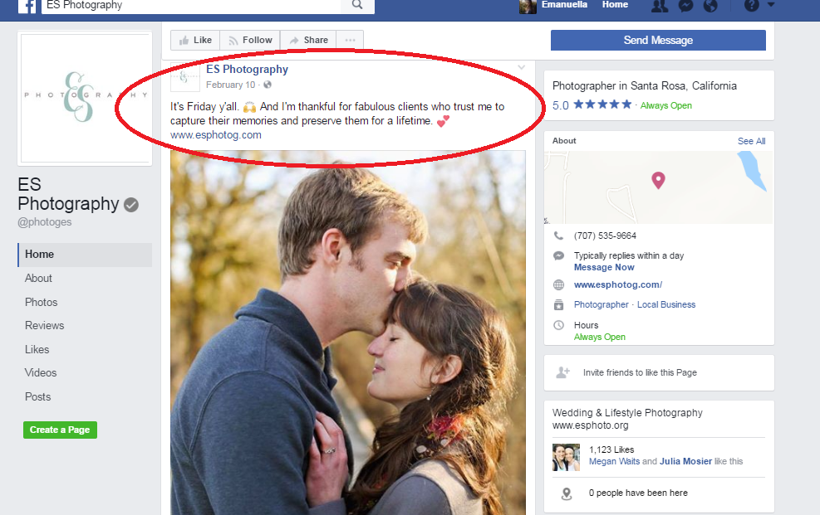
Building an Online Presence

Slide 18
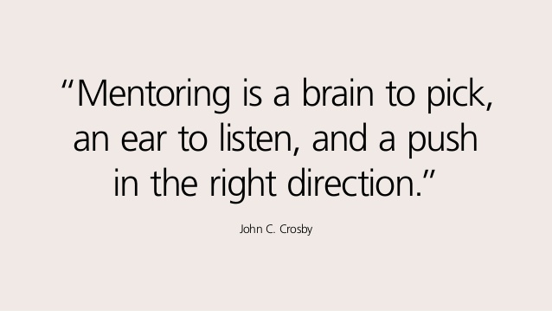
Finding a Mentor

Slide 19
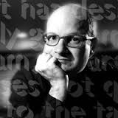
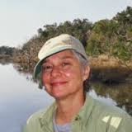
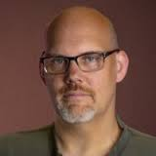
Finding Mentor
Some notable UC Davis Design Professors include:
Steve Mehallo
20 years in Graphic Design
email@mehallo.com
Laurie Szujewska
Artist, printmaker, typographer
lauszu@ucdavis.edu
William Mead
Web Designer
wmmead@ucdavis.edu
Why reach out to people?
Notes:
Why reach out to these people?
-local professors in Davis
-similar experiences to what you do
-after this meeting you can talk to them about advice about your business and problems they may have had during their careers
-advice regarding graphic design
BE SURE TO EMPHASIZE THAT WE RECOMMEND THAT AARON CONTACTS THESE PEOPLE BUT NOT THAT WE REQUIRE HIM TO DO SO. WE DID NOT CHECK IF THEY ARE ON BOARD. AARON IS NOT THEIR “MENTEE.” AARON IS REACHING OUT TO LEARN AND ADVICE NOT A PROGRAM

Slide 20
Looking Towards the Future (Year 1)
Business Plan
1 Year Financial Plan
Develop Specific Goals
Plan to Achieve
Notes:
small business association (SBA)

Slide 21
Post CYC
Long Term Goals
Notes:
Jordan

Slide 22


Community Involvement
Possible ways to get Involved
1. Sponsoring Events (Donations)
2. Pro-bono Service
Benefits of Sponsoring and Community Involvement
Red Bull- Sponsoring sport events
helped them increase sales and
solidify their brand.
MWQ Designs- Local competitor.
Taking advantage of sponsorship
by offering service to events or
organizations that run social events.
Notes:
Taymour
Red Bull- wasn't always so popular. When energy drinks were first introduced to the public, they weren't immediately successful. Red Bull did take off, however, when the company started giving away drinks at VIP and sporting events. Now, Red Bull is one of the most in-demand energy drinks in the world

Slide 23

Community Involvement Opportunities
Community Events and Options:
Chamber of Commerce Events
Davis Dash
Willet Elementary
Davis Music Fest
International Festival
Davis Musical Theatre
Yolo County Suicide Hotline
The BUZZ UC Davis Event
Takeaways:
A lot of opportunities/options Will probably take some money
Will help you build your reputation ($50-300)
Note: You can still get your name out in the community without donations and pro-bono service by focusing your services on organizations and events that are community focused.

Slide 24




Adobe Certified Associate
What is it?
Why should you do it?
“certifies that individuals have the entry-level skills to plan, design, build and maintain effective communications using different forms of digital media. This Adobe certification demonstrates entry-level skills with Adobe digital media software”
Displayed on the Adobe Certification Database
Build Technical expertise
improve efficiency, produce higher quality products in less time
Retain and Gain new clients
having expertise can set you apart from competitors
Notes:
sharpen your already refined skills. get exposure to dreamweaver or flash

Slide 25
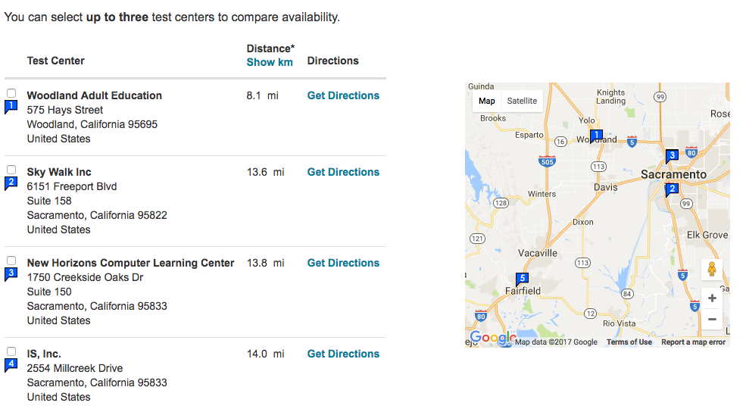
How to Become Adobe Certified?
ACA Exams for
Photoshop
Flash Professional
Dreamweaver
All exams $180.00
About 75 minutes
Two part Examination
60 MC
Short survey about product experience
Minimum passing score 70-75%
Notes:
schedule online with PearsonVue, third party
locations all around, including woodland

Slide 26
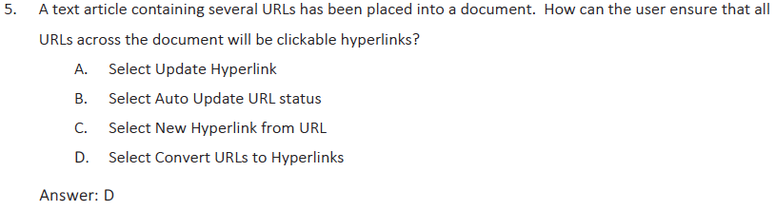
Sample Adobe InDesign
Adobe Certified Expert - InDesign 2015
Exam preparation checklist
I have at least two years of experience with InDesign.
I can create short and long documents with both text and graphics.
I can add basic interactive features to documents.
I can export high quality PDF documents appropriate for print and interactive purposes.
I can troubleshoot issues related to page layout.
I can analyze and work with documents built by another user.
I am familiar with Photoshop, Illustrator, and Acrobat Professional.

Slide 27
Looking Towards the Future (Years 2-5)
Lectures or Seminars
Write a Pamphlet
Update Portfolio
Learn New Skills
Be True to Company
Notes:
A List Apart.com (A Resource website for website makes)
Millo.co (A resource for entrepreneurs to start their own design firms or freelance)

Slide 28
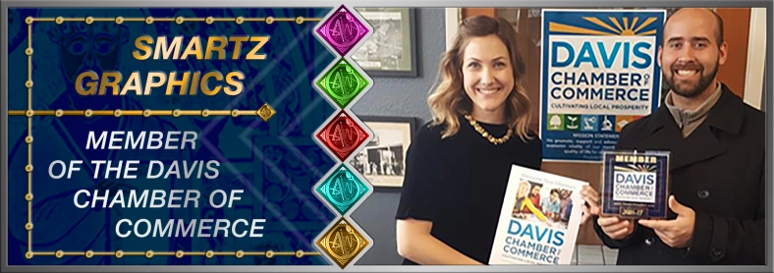
Recommendation
Short Term
Long Term
Website
Social Media
Business Plan
Deeper Community Relationship
Adobe Certification
The Future is Bright
In order to grow brand
Notes:
If you want to stay constant: do what we recommend
if you want to grow: do what we say more aggressively
If you want a community reputation focus services on the

Slide 29
Thank You
Questions?

